Slide 1
Mobile Application Dev
SCS 2210
Lecture 3: Platform and Development Framework

Slide 2
3.1 Android Studio and Flutter installation
Set up an editor
You can build apps with Flutter using any text editor combined with our command-line tools. However, we recommend using one of our editor plugins for an even better experience. These plugins provide you with code completion, syntax highlighting, widget editing assists, run & debug support, and more.
Follow the steps below to add an editor plugin for Android Studio, IntelliJ, VS Code, or Emacs.
Install the Flutter and Dart plugins
The installation instructions vary by platform.
MacOS
Start Android Studio.
Open plugin preferences (Preferences > Plugins as of v3.6.3.0 or later).
Select the Flutter plugin and click Install.
Click Yes when prompted to install the Dart plugin.
Click Restart when prompted.
Linux or Windows
Use the following instructions for Linux or Windows:
1. Open plugin preferences (File > Settings > Plugins).
2. Select Marketplace, select the Flutter plugin and click Install.

Slide 3
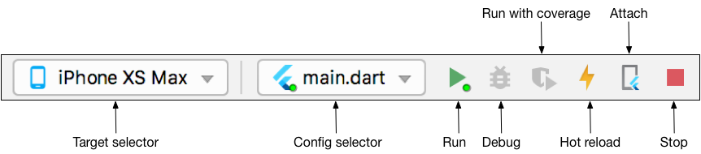
3.1 Android Studio and Flutter installation continued..
Create the app
Open the IDE and select New Flutter Project.
Select Flutter, verify the Flutter SDK path with the SDK’s location. Then click Next.
Enter a project name (for example, my_app).
Select Application as the project type. Then click Next.
Click Finish.
Wait for Android Studio to create the project.
Run the app
Locate the main Android Studio toolbar:
In the target selector, select an Android device for running the app. If none are listed as available, select Tools > AVD Manager and create one there.
Click the run icon in the toolbar, or invoke the menu item Run > Run.

Slide 4
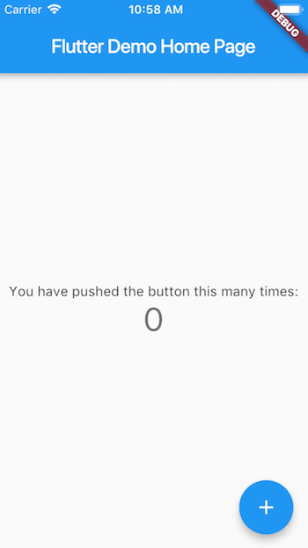
3.1 Android Studio and Flutter installation continued..
Create the app
After the app build completes, you’ll see the starter app on your device.

Slide 5
3.2 Components of Android Studio
Introduction
There are four main Android app components: activities, services, content providers, and broadcast receivers. Whenever you create or use any of them, you must include elements in the project manifest.
Service
A service in Android is a background process. Services are typically used for processes that are ongoing or that take a significant period of time. A service doesn't have a user interface, so they are often combined with other components such as activities. A typical example is an app in which an activity starts a service running on user interaction, with the service perhaps uploading data to a web resource. The user can continue to interact with the activity while the service runs because it executes in the background.
2. Content Providers
A content provider is a component for managing a data set. This data set can be private to your application or can be shared, with other apps able to query and modify the data. If you create a content provider to manage data for your own app, your UI components such as activities will use the content provider, typically through the content resolver class to interact with the data. When used by other apps, the content provider manages access to the data through standard methods to interact with structured data sets such as databases.

Slide 6
3.2 Components of Android Studio continued…
3. Broadcast receivers
The Android system makes various types of broadcasts an app can respond to. You can also develop apps to make these broadcasts, but this is far less likely than to listen for existing broadcasts, at least for your first apps. System announcements include information about the device's hardware, such as the battery level, the screen shutting off, the charger being plugged into an outlet, etc.
To receive broadcast announcements on Android, your apps can use a broadcast receiver.
4. Activities
Activities are said to be the presentation layer of our applications. The UI of our application is built around one or more extensions of the Activity class. By using Fragments and Views, activities set the layout and display the output and also respond to the user’s actions. An activity is implemented as a subclass of class Activity.

Slide 7
3.3 Creating Simple Flutter Application in Android Studio
Create the app
Open the IDE and select New Flutter Project.
Select Flutter, verify the Flutter SDK path with the SDK’s location. Then click Next.
Enter a project name (for example, my_app).
Select Application as the project type. Then click Next.
Click Finish.
Wait for Android Studio to create the project.
Replace the contents of lib/main.dart with the following code, which displays “Hello World” in the center of the screen.
import 'package:flutter/material.dart';
void main()
{ runApp(const MyApp());
}
class MyApp extends StatelessWidget {
const MyApp({Key? key}) : super(key: key);
@override
Widget build(BuildContext context) {
return MaterialApp(
title: 'Welcome to Flutter',
home: Scaffold(
appBar: AppBar(
title: const Text('Welcome to Flutter'), ),
body: const Center(
child: Text('Hello World'),
), ), ); } }

Slide 8
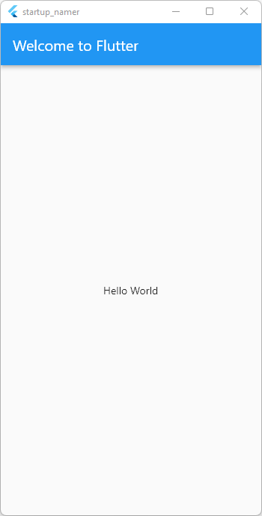
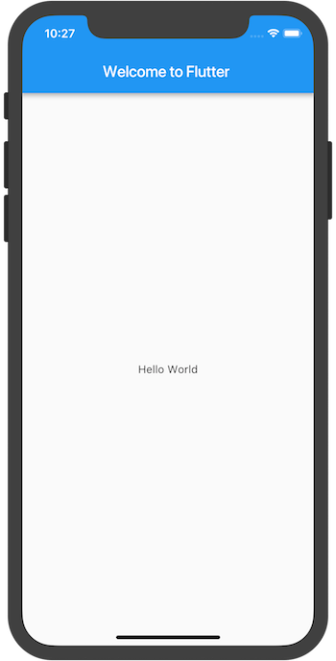
3.3 Creating Simple Flutter Application in Android Studio continued..
Run the app in the way your IDE describes. You should see either Android, iOS, Windows, Linux, macOS, or web output, depending on your device.

Slide 9
3.4 Flutter Application Architecture
Flutter Architecture
The Flutter architecture mainly comprises of four components.
Flutter Engine
Foundation Library
Widgets
Design Specific Widgets
Flutter Engine
It is a portable runtime for high-quality mobile apps and primarily based on the C++ language. It implements Flutter core libraries that include animation and graphics, file and network I/O, plugin architecture, accessibility support, and a dart runtime for developing, compiling, and running Flutter applications. It takes Google's open-source graphics library, Skia, to render low-level graphics.
Foundation Library
It contains all the required packages for the basic building blocks of writing a Flutter application. These libraries are written in Dart language.

Slide 10
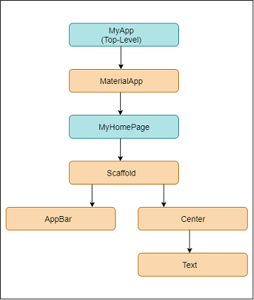
3.4 Flutter Application Architecture continued..
Widgets
In Flutter, everything is a widget, which is the core concept of this framework. Widget in the Flutter is basically a user interface component that affects and controls the view and interface of the app. It represents an immutable description of part of the user interface and includes graphics, text, shapes, and animations that are created using widgets.
In Flutter, the application is itself a widget that contains many sub widgets.
We can understand it from the hello world example

Slide 11
3.4 Flutter Application Architecture continued..
Design Specific Widgets
The Flutter framework has two sets of widgets that conform to specific design languages. These are Material Design for Android application and Cupertino Style for IOS application.
Gestures
It is a widget that provides interaction (how to listen for and respond to) in Flutter using GestureDetector. GestureDector is an invisible widget, which includes tapping, dragging, and scaling interaction of its child widget. We can also use other interactive features into the existing widgets by composing with the GestureDetector widget.
State Management
Flutter widget maintains its state by using a special widget, StatefulWidget. It is always auto re-rendered whenever its internal state is changed. The re-rendering is optimized by calculating the distance between old and new widget UI and render only necessary things that are changes.

Slide 12
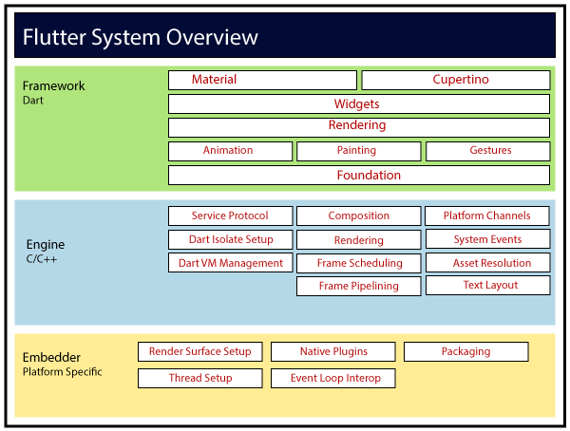
3.4 Flutter Application Architecture continued..
Layers
Layers are an important concept of the Flutter framework, which are grouped into multiple categories in terms of complexity and arranged in the top-down approach. The topmost layer is the UI of the application, which is specific to the Android and iOS platforms. The second topmost layer contains all the Flutter native widgets. The next layer is the rendering layer, which renders everything in the Flutter app. Then, the layers go down to Gestures, foundation library, engine, and finally, core platform-specific code. The following diagram specifies the layers in Flutter app development.

Slide 13
3.5 Flutter Development Tools
Development Tools
Android
IntelliJ
DevTools: - a suite of performance and debugging tools for Dart and Flutter.
Supernova: - is a powerful design-to-code tool that converts your Sketch and Adobe XD mobile designs into native front-end code for iOS, Android, React Native, and of course, Flutter.
Panache:- is an open-source, browser-based material theme editor for Flutter that allows you to create beautiful and highly customizable themes for your Flutter app.

